Slide 1


American Heart Association Heart Walk Events
-Identify Potential Zero Dollar Walker
Group 3: Pei-Chun Lin, Vashisth Sorathia, Sharon Wu

Slide 2

Agenda
Introduction & Objective
Zero Dollar Walker Defined
Data Overview & Exploration
Data Cleansing
Variables Selection
Solution Approach
Segmentation
Logistic Regression Model
Financial Implication
Recommendations

Slide 3


Introduction & Objective
Problem Definition - “Zero Dollar Walker”
Each year approximately 58% of Heart Walk participants fail to raise funds
Massive opportunity in converting this chunk of participants – a 5% increase in donations would mean 2M in revenue
How to identify these Zero Dollar Walkers ??
Objective
Using historic data, study common characteristics of a Zero Dollar Walker and utilize this learning to hint if a given participant is potentially one
Deploying a real-time scalable learning model will help AHA to deal with such participants in advance and present an opportunity to proactively convert them

Slide 4
Zero Dollar Walker Defined
Zero Dollar Walker- any participant that has an aggregate total gift amount of 0 for an event year
A participant may be a ZDW for a given year but not for another year based on gift amounts
Aggregate Gift Amount by Participant ID and Event Year. If total gift amount of 0 for an event year, ZDW flag = 1
 | Number of Participant (2014 to 2016)
ZDW | 622,052
non-ZDW | 391,428
Total | 1,013,480

Slide 5

Data Overview
Total 1,624,391 records: the records are transaction-based, one participant may have several records
Total 43 variables: the variables include
Geographic Information : Stdhomeaddress.City, Stdhomeaddress.State
Income : Meddi.Cy, Medhinc.Cy, Mednw.Cy
Lifestyle : Tapsegnum,Tap.Desc, Tap.Lifed, Tap.Life
Historical Behavior : Lifetimetotal.Transamount, Prevyeartotal.Transamount
Transaction Information : Giftamount, Registration.Gift

Slide 6
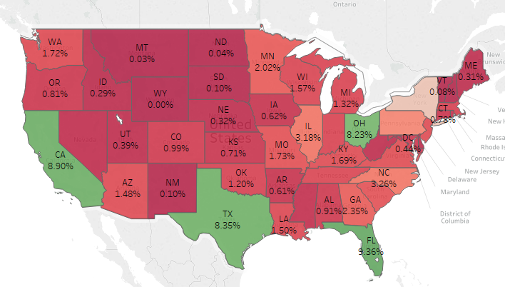
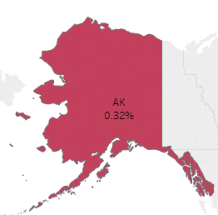

Data Overview
FL(9.36%), CA ,OH, TX and NY(5.12%) have high concentration of participants

Slide 7
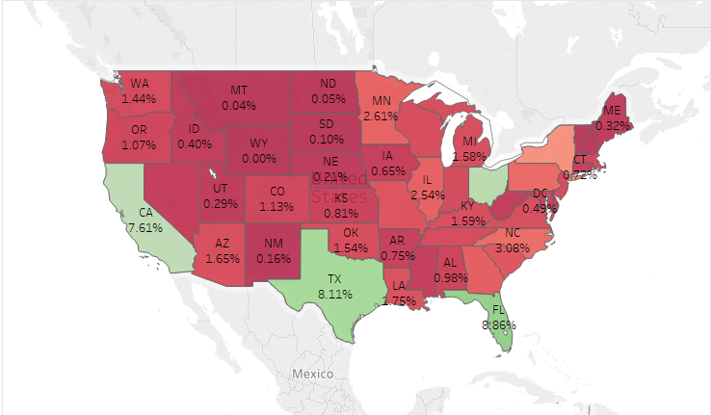
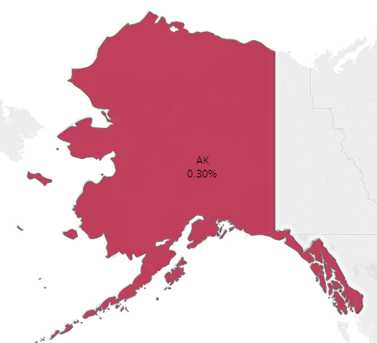
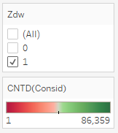
Data Overview
However, those States also have high concentration of Zero Dollar Walkers

Slide 8
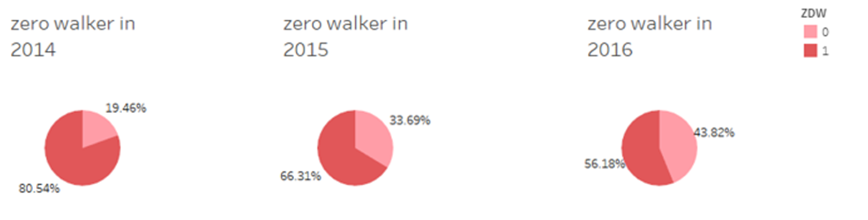
Data Exploration
1 represents zero dollar walker and 0 represents non-zero dollar walker
Based on gift amount and event year, we can see zero dollar walker decreases every year
However, zero dollar walker still have more than half of the participant population

Slide 9
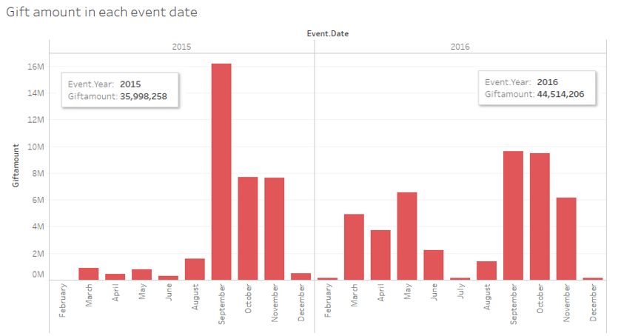
Data Exploration
The highest gift amount is in September 2015
Total gift amount increased 20% from 2015 to 2016

Slide 10
Data Cleansing
9 variables with more than 99% missing value will be ignored
Replacement of missing value:
 | Original Value | Replace Value | Note
Tapestry Life (Tap.Life) | <blank> | 15 | LifeMode 15 is unclassified
Tapestry Segment Number (Tapsegnum) | <blank> | 68 | While LifeMode is unclassified(15), Segment ID is 68
Gift Amount | <blank> | 0 | No donation

Slide 11
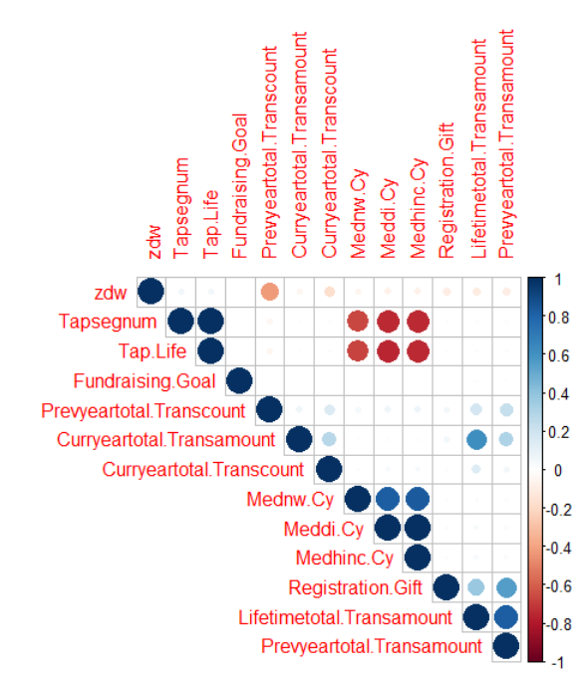
Variables Selection
Meddi Cy, Medhinc Cy and Mednw Cy are highly correlation -> keep only Median Household Income
TapLife and Tapsegnum are highly correlation and they are correlated with income -> use Tapesry Life for segmentation
Lifetimetotal.Transamount is highly correlated with Prevyeartotal.Transamount -> keep Previous Year Total Transaction Amount

Slide 12
Solution Approach
Data Exploration
Segmentation
Financial Implication
Prediction

Slide 13
Segmentation
Segment 1- High Gift Amount Participate
Segment each group by Tapestry Life and level of average gift amount
Segment 1 -> Avg Gift Amount > $200
Segment 2 -> Avg Gift Amount between $190 and $200
Segment 3 -> Avg Gift Amount <$190
Segment 4 -> no income information participants

Slide 14
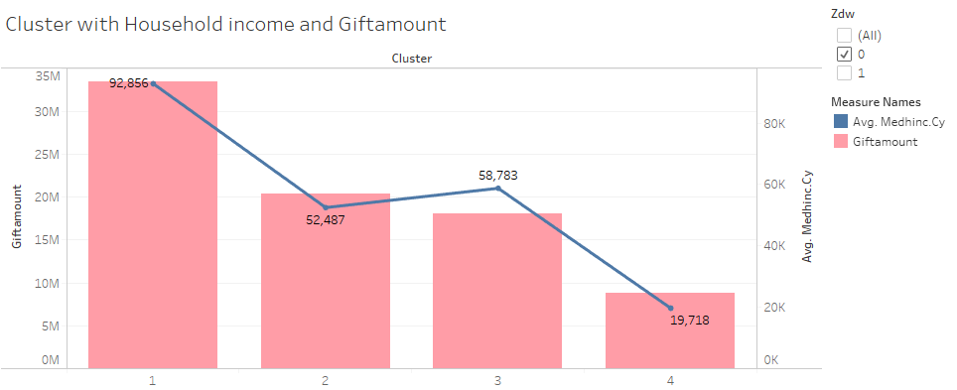
Segmentation
For non-zero dollar walkers, people who have higher income are more likely to have higher gift amount

Slide 15
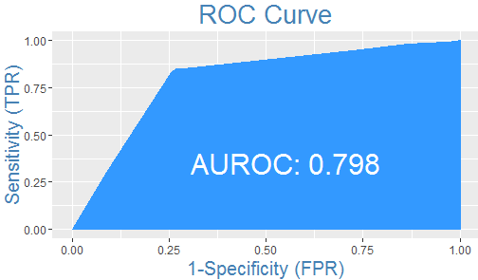
Logistic Regression Model Segment 1 - High Gift Amount Participate
Choose variables with importance > 1
ROC = 0.798 in Segment 1
Segment 1
 |  | Actual
 | ZDW | 0 | 1
Predicted | 0 | 29349 | 10740
 | 1 | 6541 | 36483
Accuracy = 79.21%

Slide 16
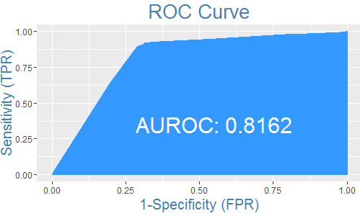
Logistic Regression Model Segment 2 - Middle Gift Amount Participate
Choose variables with importance > 1
ROC = 0.8162 in Segment 2
Segment 2
 |  | Actual
 | ZDW | 0 | 1
Predicted | 0 | 21439 | 10033
 | 1 | 3158 | 38029
Accuracy = 81.85%

Slide 17
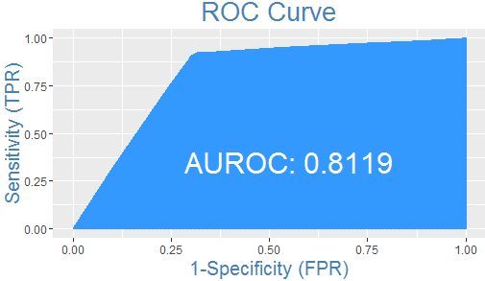
Logistic Regression Model Segment 3 - Low Gift Amount Participate
Choose variables with importance > 2
ROC = 0.8119 in Segment 3
Segment 3
 |  | Actual
 | ZDW | 0 | 1
Predicted | 0 | 21008 | 9668
 | 1 | 3123 | 38444
Accuracy = 82.29%

Slide 18
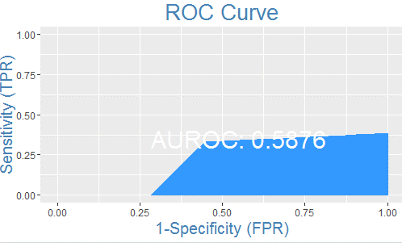
Logistic Regression Model - Overall
Choose variables based on 3 segments
ROC = 0.5876 in whole dataset
 | segment 1 | segment 2 | segment 3
Curryeartotal.Transamount | V | V | V
Curryeartotal.Transcount | V | V | V
Fundraising.Goal |  | V
Medhinc.Cy | V | V | V
Prevyeartotal.Transamount | V | V | V
Prevyeartotal.Transcount | V | V | V
Registration.Gift
Overall
 |  | Actual
 | ZDW | 0 | 1
Predicted | 0 | 55890 | 17457
 | 1 | 9956 | 67147
Accuracy = 81.78%

Slide 19
Financial Implication - Segment 1
83.1k Users | Expected response rate of 50%
Using this model, if we want to reach 30k ZDWs, we need to target only 39k users instead of 58.1k users (without the logistic regression model)
Savings of ~33% in marketing costs compared to baseline scenario
Decile | Cases | ZDW | Cumulative ZDW | Cumulative Cases | Responses Expected | Cumulative Responses Expected
1 | 8,311 | 6,522 | 6,522 | 8,311 | 4,156 | 4,156
2 | 8,311 | 6,526 | 13,048 | 16,622 | 4,156 | 8,311
3 | 8,311 | 6,473 | 19,521 | 24,933 | 4,156 | 12,467
4 | 8,311 | 6,496 | 26,017 | 33,244 | 4,156 | 16,622
5 | 8,311 | 6,450 | 32,467 | 41,555 | 4,156 | 20,778
6 | 8,311 | 4,493 | 36,960 | 49,866 | 4,156 | 24,933
7 | 8,311 | 1,659 | 38,619 | 58,177 | 4,156 | 29,089
8 | 8,311 | 1,648 | 40,267 | 66,488 | 4,156 | 33,244
9 | 8,311 | 1,447 | 41,714 | 74,799 | 4,156 | 37,400
10 | 8,311 | 1,310 | 43,024 | 83,110 | 4,156 | 41,555

Slide 20
Financial Implication - Segment 2
72.6k Users | Expected response rate of 50%
Using this model, if we want to reach 30k ZDWs, we need to target only 36k users instead of 59k users (without the logistic regression model)
Savings of ~39% in marketing costs compared to baseline scenario
Decile | Cases | ZDW | Cumulative ZDW | Cumulative Cases | Responses Expected | Cumulative Responses Expected
1 | 7,266 | 5,904 | 5,904 | 7,266 | 3,633 | 3,633
2 | 7,266 | 5,960 | 11,864 | 14,532 | 3,633 | 7,266
3 | 7,266 | 5,786 | 17,650 | 21,798 | 3,633 | 10,899
4 | 7,266 | 5,817 | 23,467 | 29,064 | 3,633 | 14,532
5 | 7,266 | 5,899 | 29,366 | 36,330 | 3,633 | 18,165
6 | 7,266 | 5,678 | 35,044 | 43,595 | 3,633 | 21,798
7 | 7,266 | 3,360 | 38,404 | 50,861 | 3,633 | 25,431
8 | 7,266 | 901 | 39,305 | 58,127 | 3,633 | 29,064
9 | 7,266 | 1,006 | 40,311 | 65,393 | 3,633 | 32,697
10 | 7,266 | 876 | 41,187 | 72,659 | 3,633 | 36,330

Slide 21
Financial Implication - Segment 3
72.2k Users | Expected response rate of 50%
Using this model, if we want to reach 25k ZDWs, we need to target only 30.3k users instead of 50k users (without the logistic regression model)
Savings of ~39.4% in marketing costs compared to baseline scenario
Decile | Cases | ZDW | Cumulative ZDW | Cumulative Cases | Responses Expected | Cumulative Responses Expected
1 | 7,224 | 5,909 | 5,909 | 7,224 | 3,612 | 3,612
2 | 7,224 | 5,824 | 11,733 | 14,449 | 3,612 | 7,224
3 | 7,224 | 5,752 | 17,485 | 21,673 | 3,612 | 10,836
4 | 7,224 | 5,756 | 23,241 | 28,897 | 3,612 | 14,449
5 | 7,224 | 5,822 | 29,063 | 36,122 | 3,612 | 18,061
6 | 7,224 | 5,831 | 34,894 | 43,346 | 3,612 | 21,673
7 | 7,224 | 3,940 | 38,834 | 50,570 | 3,612 | 25,285
8 | 7,224 | 971 | 39,805 | 57,794 | 3,612 | 28,897
9 | 7,224 | 862 | 40,667 | 65,019 | 3,612 | 32,509
10 | 7,224 | 900 | 41,567 | 72,243 | 3,612 | 36,122

Slide 22
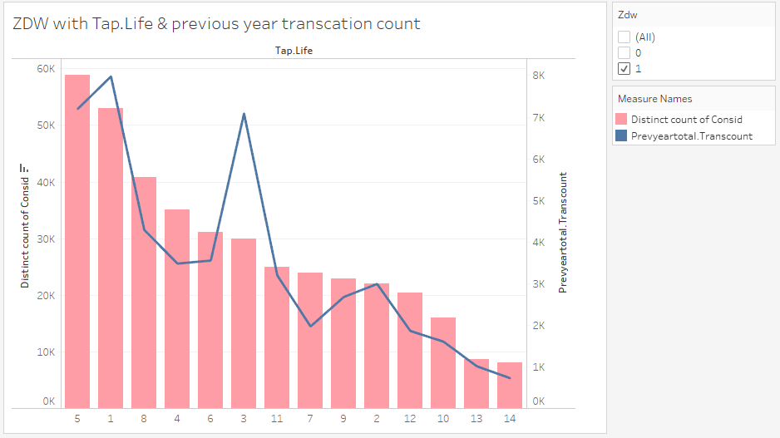
Recommendations
Previous Year Total Transaction Count is an important indicator:
In the logistic regression model, Participants who had no or very few transactions previous year are more likely to be ZDW. In the ZDW, there are lots of participants in Tap life 1 and 5 have higher transaction count meaning AHA can focus on those participants first.

Slide 23
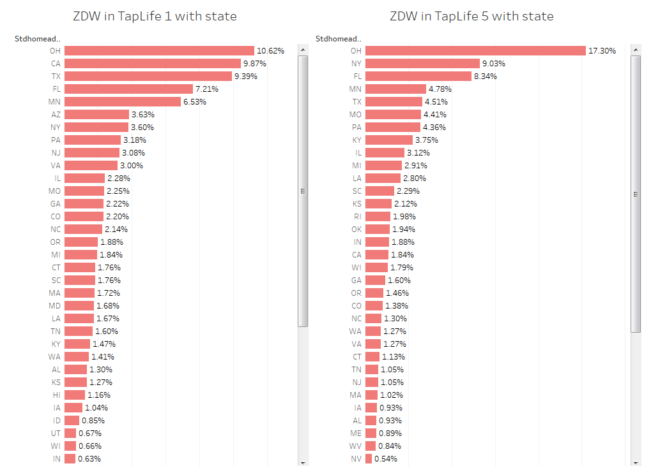
AHA can specifically focus on Tap life 1 ZDW in OH, CA and TX, and Tap life 5 ZDW in OH, NY and FL and try having them make donations.

Slide 24

Recommendations
Special marketing strategy on Segment 1 (Average Gift Amount > $200)
Tapestry Life = 1 (Affluent Estates) : Participate actively in their communities
Tapestry Life = 2 (Upscale Avenues) : Active in fitness pursuits like bicycling, jogging and aerobics
Tapestry Life = 3 (Uptown Individuals) : Young, successful singles in the city
Tapestry Life = 9 (Senior Styles) : Senior lifestyles reveal the effects of saving for retirement
Tapestry Life = 14 (Scholars and Patriots) : Highly social, free time is spent enjoying music and drinks with friends
-> About 50% participants in this segment are ZDW. If AHA can lower the percentage, there will be a big increase in donation amount.

Slide 25


